Slide 1
Educational Credentials Ecosystem
USE CASE

Slide 2
Educational Credentials Ecosystem
Learn
Convene
Define
Create
Implement
Operate
Grow

Slide 3
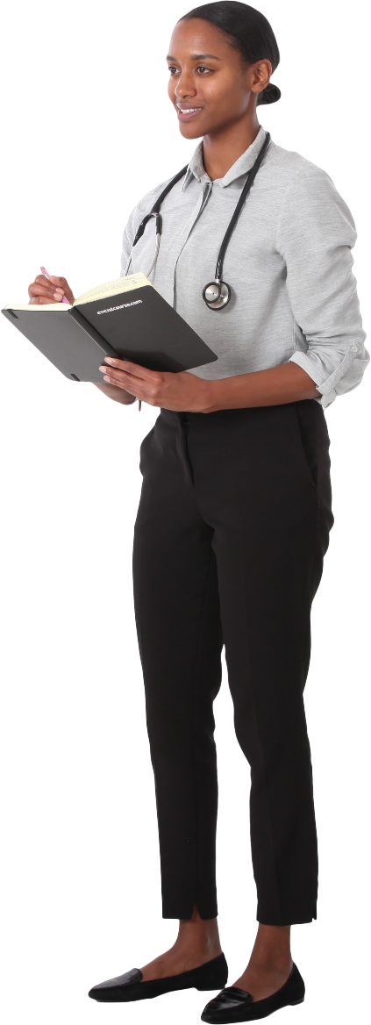
Find a job in Canada
Katherine
Study: 9am-3pm
Work: 5pm-9pm
Homework: 9pm-00am
PU – knowledge, achievement
PH – behaviour, skills
Home – attitudes, values

Slide 4
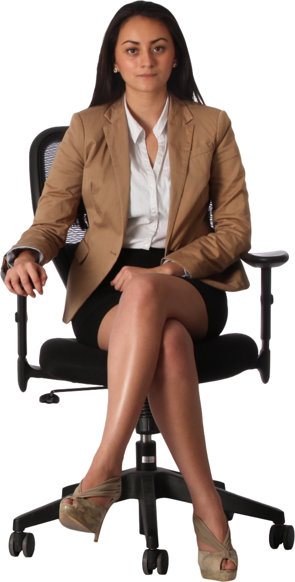
Elise: Learn, Convene
Policies
Standards
Online education (COVID-19)
Trust Over IP

Slide 5
Elise
Policies
Standards
IVEC ecosystem
Define Create Implement
Jane
Tracy
Increase enrolment
Reduce paperwork
Trustworthy
Foreign experience

Slide 6
IVEC ecosystem
Operate Grow
Diego
Maria
Internationalize Philippine credentials
Open door to new markets
Internationalize Philippine working experience
Bring back professionals with foreign experience

Slide 7
Ecosystem
Katherine
Hard work
Talent
PU – badge
PH – badge
IVEC

Slide 8
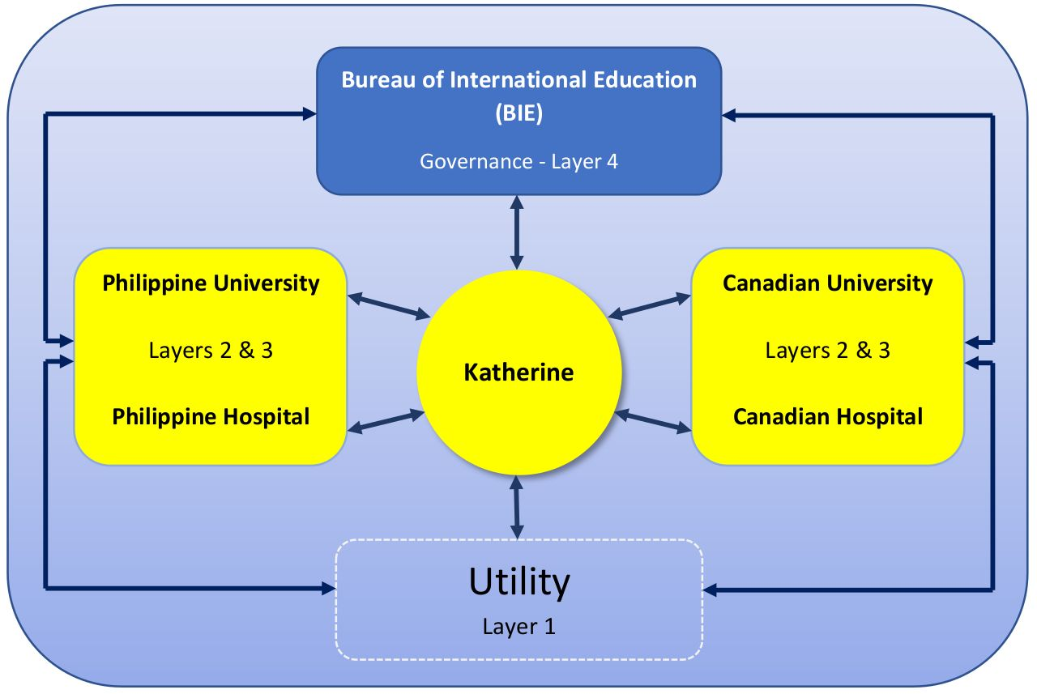

Slide 9
